Slide 1
Future of health and care in Sefton
Eleanor Moulton
Integrated Social Care and Health Manager
Sefton Integrated Care Partnership and Sefton Council
Notes:
Before next slide – question for you all – please post your answers in the chat.
How much do you think is spent by the CCGs and Sefton Council Adult and Social Care on caring for the people of Sefton each year?

Slide 2
Money available
Combined spend of CCGs and Sefton Council Adult and Social Care:
£748 million
Notes:
Together the CCGs in Sefton and Adult and Children's Social care spend £748 million pounds.
That’s double the net spent on transfers of Liverpool and Everton football clubs combined over the last 5 years.
Really demonstrates the need in Sefton but also the opportunity we have to try and make a big difference.

Slide 3
Integration
Long term aim for Sefton health and care services
Person focused care and support
Everyone working together
Avoids duplication
Better value for money
Getting it right first time
Health & Care Bill – legislation to support integration
Notes:
An idea that's been around for a long time, it would make things easier for the person who needs Care and Support, if they only have to tell their story once, it doesn’t matter which door they go through they will get everything they need. It stops things being done twice and costs less money if its done in the simplest and most straightforward way with everyone working together to do the best they can for the person in front of them.
The Health & Care Bill currently going through Parliament will support this long term aim with changes and legislation to support integration of health and care services.

Slide 4
July 2021 – Health and Care Bill
Notes:
This is how that integration will look – with England split into Integrated Care Systems – ours being Cheshire and Merseyside Health and Care Partnership, which contains:
Place based partnerships – everyone that works in Sefton for the NHS or Social Care
Integrated Care Board – Will decide on things which stay just in the NHS for Cheshire and Merseyside,
Integrated Care Partnership will organise things and work with the palce based parttnserhisp to try and get the best offer for Sefton as one 9 places in Cheshire and Merseyside
Provider Collaboratives – NHS trusts working together on big footprint around things they do well. Like Specialist Mental Health, this is still not fully decided.

Slide 5
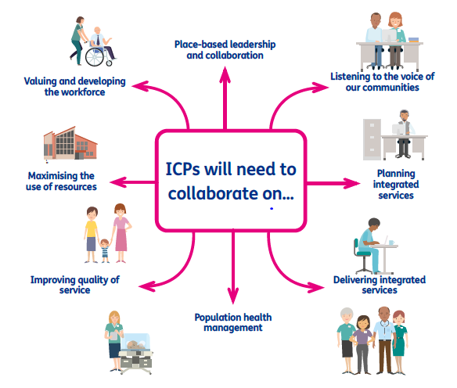
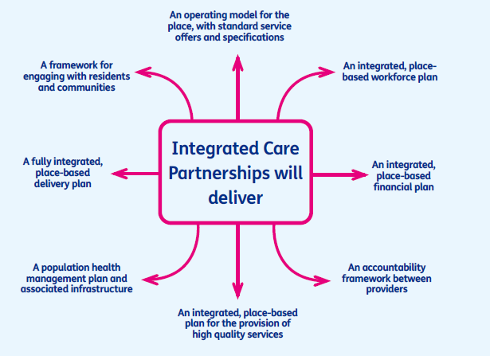
What will we do in Sefton
Place based partnerships
Place based partnerships
Notes:
A Place based partnership of locally you might hear it called the Sefton Integrated Care Partnership (ICP) is a collaboration of planners and providers across health, local authority and the wider community, who take collective responsibility for improving the health and wellbeing of residents within a place, the place of Sefton.
All age service provision at place level, working together to simplify and modernise care and implement service models which deliver improved outcomes
Public health and wider community development
Community-based wellbeing support, including social prescribing activities, VCFSE provision and local access to green spaces, and leisure facilities
GP and wider primary care, delivered through Primary Care Networks
Community mental health care
Urgent & emergency care, including physical & mental health (in part through ‘system’ networks)
Ongoing management of long term conditions, including the use of skills, expertise and resources that have historically been accessed via referral to acute care services
Social care, education, housing, employment and training support

Slide 6
What will be different?
‘One team’ approach – free from organisational barriers and using our joint resources
Making decisions together and reducing need for separate meetings
Pooled budgets to get the best value for money and make the most of the Sefton £
What people in Sefton need isn’t changing – the way the health and care system meets those needs is changing
Notes:
We are being asked think of ourselves as one team and focus on what people really need and to forget about barriers like different organizations or doing things separately without thinking about things together as part of our jobs and with the public. This will use the best of what we have available to us
Now things might have to go through two or three separate sets of meetings to decide things and get them done in the future there will be one big meeting that everyone makes a decision together
We will put our money together in a pooled budget to help get the most out of it.
This doesn’t change what people in Sefton need, it changes the way Health and Care do something about it.
The next slides explain that we already know what has to be done, through the HWBB Strategy and NHS 5 year Plan, Sefton2gether.

Slide 7
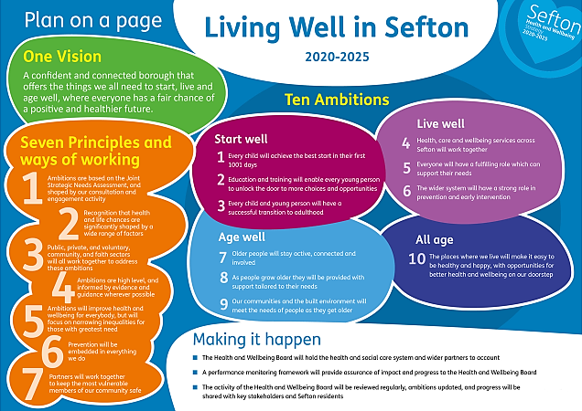
What is an ICP and what does it do?
Notes:
Work underway to deliver a single set of combined HWBS and Sefton2gether priorities, and indicators that will tell us we are making a difference.
EMPHASISE HOW CURRENT WORK BUILDS ON WHAT HAS ALREADY BEEN DONE WITH PEOPLE OF SEFTON TO IDENTITY WHAT THEY NEED AND WANT FROM HEALTH AND CARE SERVICES

Slide 8
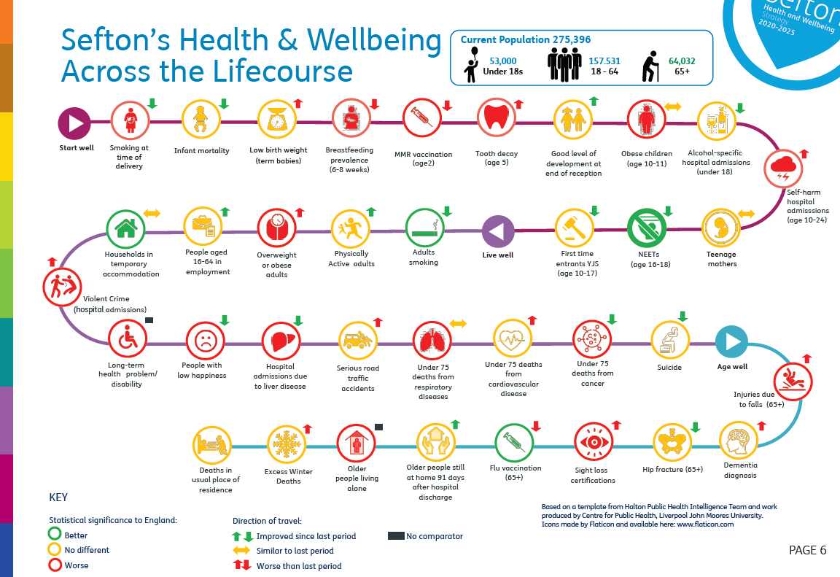
What is an ICP and what does it do?
Notes:
EMPHASISE HOW CURRENT WORK BUILDS ON WHAT HAS ALREADY BEEN DONE WITH PEOPLE OF SEFTON TO IDENTITY WHAT THEY NEED AND WANT FROM HEALTH AND CARE SERVICES

Slide 9
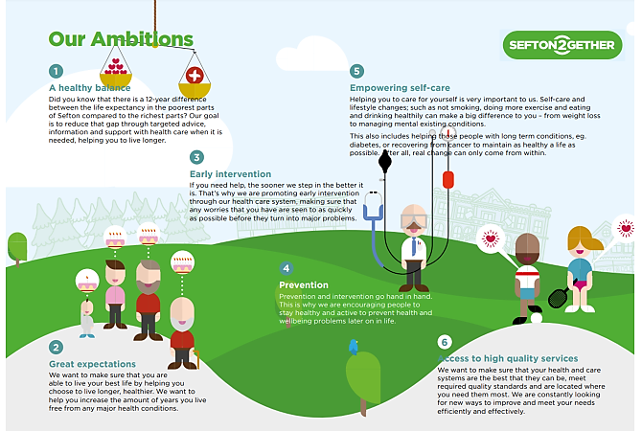
What is an ICP and what does it do?
Notes:
EMPHASISE HOW CURRENT WORK BUILDS ON WHAT HAS ALREADY BEEN DONE WITH PEOPLE OF SEFTON TO IDENTITY WHAT THEY NEED AND WANT FROM HEALTH AND CARE SERVICES

Slide 10
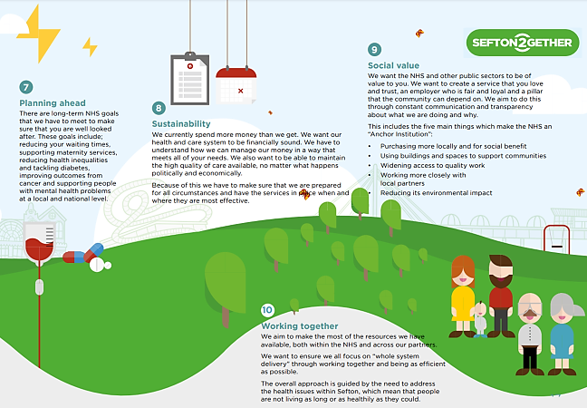
What is an ICP and what does it do?
Notes:
EMPHASISE HOW CURRENT WORK BUILDS ON WHAT HAS ALREADY BEEN DONE WITH PEOPLE OF SEFTON TO IDENTITY WHAT THEY NEED AND WANT FROM HEALTH AND CARE SERVICES

Slide 11
Current priorities
Get ready for April 2022
Strengthen community engagement and how use our health and care data
Co-create culture, principles and plan for Sefton to deliver H&WB Strategy and Sefton2gether
Helping people as early as possible or giving them the tools to help them prevent poor health
Notes:
To keep working on developing a Sefton Integrated Care Partnership quickly so we are ready for when the bill is law in April 2022. This will enable us to show that we are ready and we know what we are going to do so that the government feel able to trust us with extra money and responsibility.
To use information we find from engaging with communities and through looking at our health and care data to involve communities and their information in how we manage the health of the borough
Work together to create a culture, principles and a plan plan for Sefton that delivers on the H&WB Strategy and Sefton2gether and start testing this plan out
In terms of people’s health,, our priority is to help people as early as possible or by giving them to tools to help prevent ill health

Slide 12
Example: Care Home Forum
Multi-agency approach to managing COVID-19 for care homes
Looked beyond organisational barriers to focus on what would help the most
Helped roll out vaccinations in care homes quickly
Ensured enough PPE was available
Helped find more staff when required
Helped ensure residents received the right medication
Helped bring back visitors safely
Commitment to continue working together to get the best for people who live in Care Homes
Notes:
The Care Home Forum – During COVID a group of people from hospitals, District Nurses, GPs, all different people from across the council and CCG, met every day and saw what was happening in care homes and thought about who we could help, then whoever was best did the thing that would help the most. We didn’t think about the rules of who has a contract to do it, or whether their boss had asked it was just doing the right thing and we changed loads helping roll out vaccinations really quickly, making sure they all had enough PPE, helping them find more staff, to get the right medication, getting visitors back in safely. This has led to a commitment to keep working together like this to get the best offer for people who live in Care Homes

Slide 13
Your views
Do you think that Sefton organisations working closer together will improve services locally?
Do you feel these proposals align with our local plans (Sefton 2gether / Living Well Sefton)?
Notes:
In a second a poll will appear on your screen, it will also be available in the chat box for you to select what best matches your view

Slide 14
Any questions?
Please post your question in the chat
or raise your hand for the chair to call your name

